Slide 1
NODE.JS
(The Backend Of MERN Stack)
Lecture 28

Slide 2
Today’s Agenda
Introduction To NoSQL Databases
Recap Of SQL Databases
What Is A NoSQL Database ?
Types Of NoSQL Databases
Benefits Of NoSQL Daatabases
Comparison Between SQL DB And NoSQL DB
Which One To Use When ?

Slide 3
Introduction to nosql databases
NoSQL stands for Not only SQL.
NoSQL Databases are also known as non-relational databases that don’t require a fixed schema.
But before discussing any further on NoSQL databases let us first recall what is an SQL database.

Slide 4
Recap of sql databases
SQL stands for Structured Query Language and was created by Donald Chamberlin and Raymond Boyce at IBM in the year 1974.
It’s original name was SEQUEL( Structured English Query Language).
In 1976 it was renamed to SQL.

Slide 5
Recap of sql databases
Since then , SQL is the standard language for working with Relational Databases or SQL Databases.
In a relational database like SQL Server or Oracle or MySQL or SQLite , a database is collection of tables and these tables themselves store data in the form of rows and columns.

Slide 6
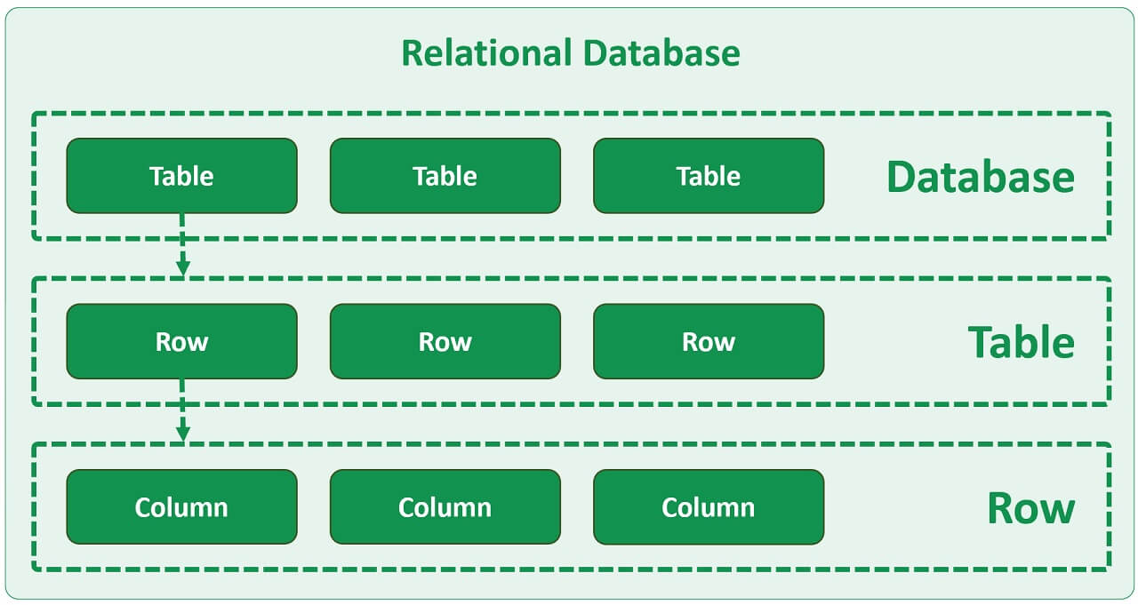
Recap of sql databases

Slide 7
Recap of sql databases
Further these tables are related to each-other using relationships or “keys”.
Meaning there is a column in one table (table A) that is designed to only point to a column in another table (table B).

Slide 8
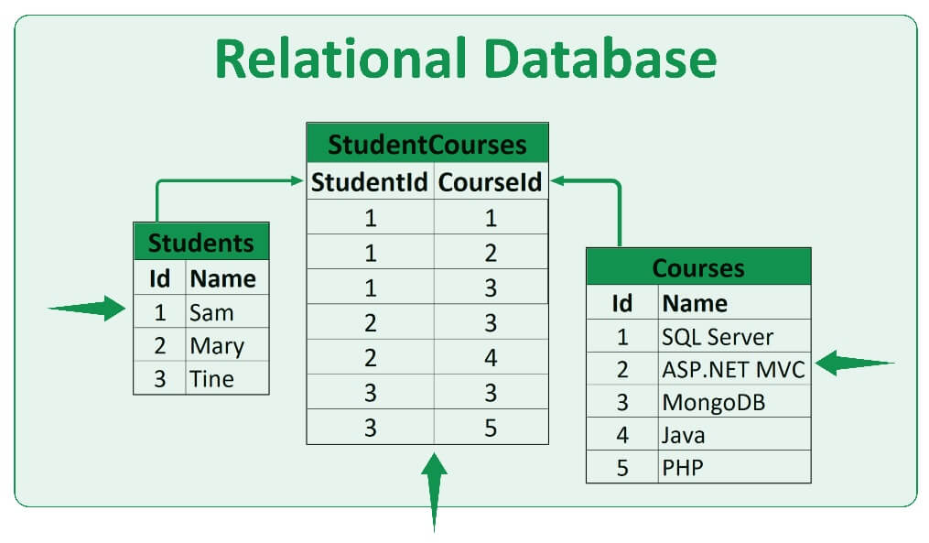
Recap of sql databases

Slide 9
What is a nosql database ?
Many beginners think that NoSQL means there is no SQL.
This is not true.
The term NoSQL stands for Not Only SQL and it means, a non-relational database is a non-tabular database and stores data differently than relational tables.

Slide 10
What is a nosql database ?
For example, as discussed before , in a relational database like SQL server or Oracle data is stored in tables whereas in a non-relational database like MongoDB data is stored in a different format.
These are called Collections and Documents.

Slide 11
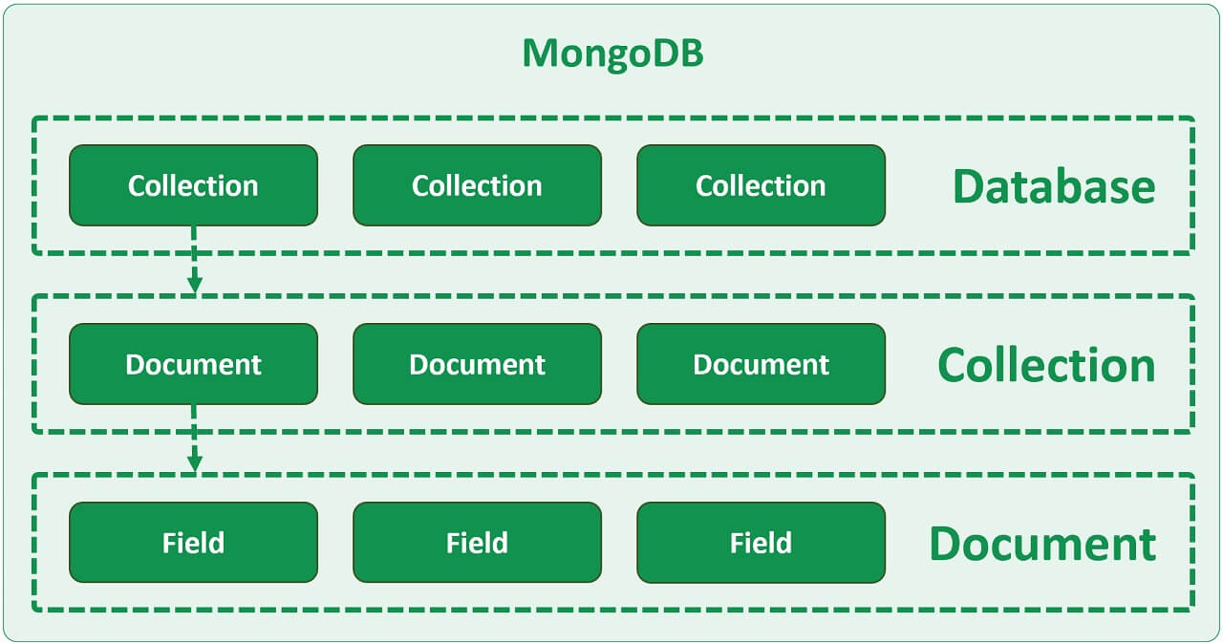
What is a nosql database ?

Slide 12
Correspondence to sql
Consider the example shown in next two slides that shows a sample database stored in both Relational and Document Database.

Slide 13
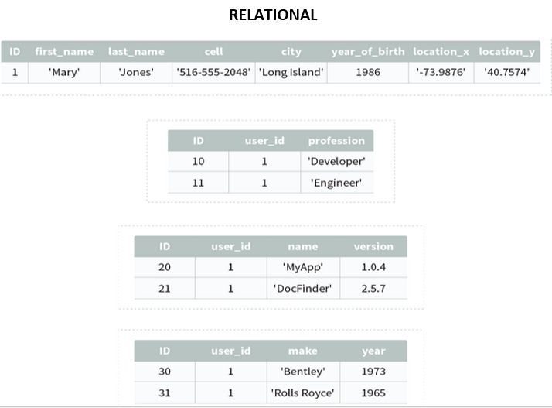
Correspondence to sql

Slide 14
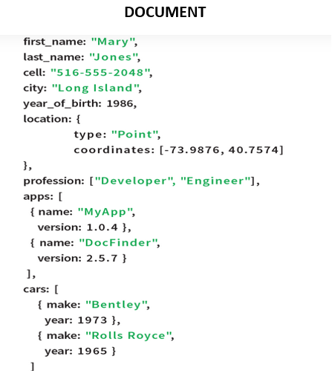
Correspondence to sql

Slide 15
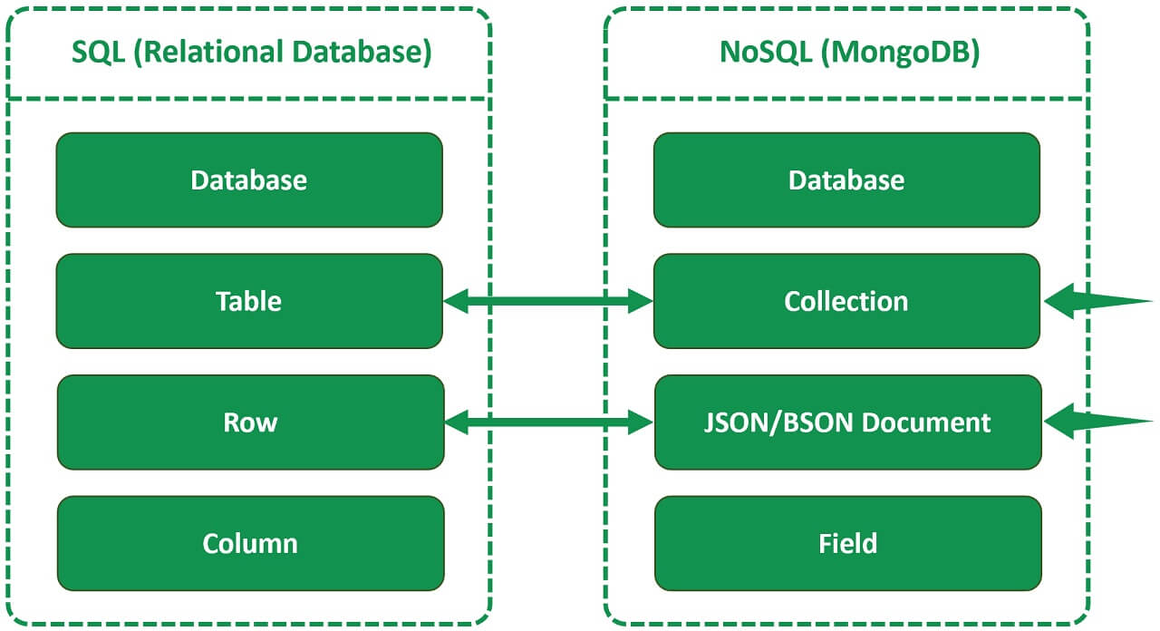
Correspondence to sql

Slide 16
Correspondence to sql
In both , SQL and non-relational world, we have Database at the top.
In SQL we have tables and in the non-relational world (like MongoDB for example) we have Collections.
Table rows in SQL world correspond to BSON documents in MongoDB. The term BSON is binary JSON. ( we will discuss it later)
A column in the SQL world corresponds to a field in a JSON document.

Slide 17
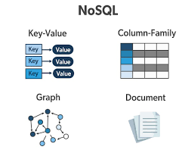
Types of nosql databases
There are 4 different types of NoSQL databases.

Slide 18
Types of nosql databases
Document Database - As the name implies data is stored in documents, for example in JSON/BSON documents.
Examples are MongoDB and CouchDB.

Slide 19
Types of nosql databases
Key-Value Database - It stores data as a collection of key-value pairs in which a key is used as a unique identifier.
Both keys and values can be anything, ranging from simple objects to complex compound objects.
Examples are DynamoDB and Redis.

Slide 20
Difference ?
A document database is, at its core, a key/value store with one major exception.
Instead of just storing any format in it, a document db requires that the data will be store in a format that the database can understand.
The format can be XML, JSON, Binary JSON (MongoDB), or just about anything, as long as the database can understand it.

Slide 21
Types of nosql databases
Wide-Column store - It is similar to a relational database in the sense it stores data in rows and columns, however the columns are dynamic and each row does not have to have the same columns.
Examples are HBase and Cassandra.

Slide 22
Types of nosql databases
Graph database - It is used to store and navigate relationships.
Heavily used in social networking as It is easy to create relationships between data entities and quickly query these relationships.
For example we can find out who the "friends of friends" of a particular person are.
Examples - Dgraph and OrientDB.

Slide 23
Benefit of nosql database ( document database)
Flexible Schema- JSON documents that actually store data have a flexible schema
It means that it is perfectly okay and normal for 2 documents to have different fields.

Slide 24
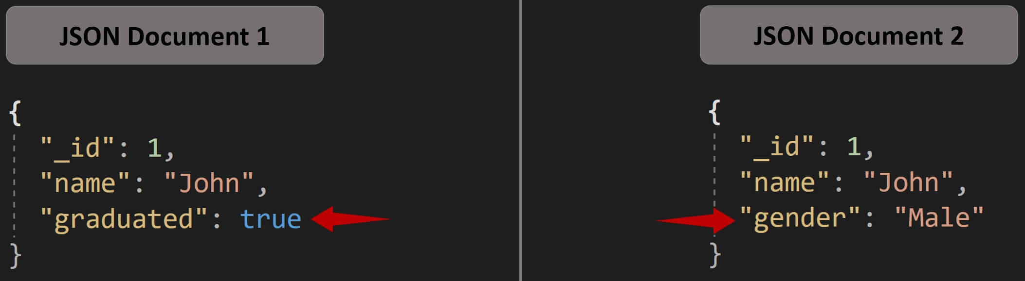
Benefit of nosql database ( document database)
1. Both the documents shown above are a part of same collection.
2. Both have id and name fields.
3. In the first document we have graduated boolean field, whereas in the second document instead of graduated we have a string gender field.
So the point is, that document schema in Mongo is dynamic and every document we save in Mongo can be as simple or as complex as our application requires.

Slide 25
Benefit of nosql database ( document database)
Easy to use data model : In a document database like MongoDB we do not have tables and rows, instead we have collections and documents.
The data that we typically store across many relational database tables can be stored in a single collection.

Slide 26
Benefit of nosql database ( document database)
For a programmer this data is very easy to work with since no complex joins and mapping layers are required.
Our application code will be much cleaner, simpler and easier to maintain.

Slide 27
Benefit of nosql database ( document database)
Easy horizontal scaling : Most SQL databases allow only vertical scaling which is also called as scaling up.
It means adding more resources (like memory, storage etc) to the existing database server to ensure that the required service can be provided to the users.

Slide 28
Benefit of nosql database ( document database)
But vertical scaling has an upper limit beyond which we cannot just add more CPU, memory etc.
There is also downtime involved.
We have to shut the database server down to add more hardware.

Slide 29
Benefit of nosql database ( document database)
MongoDB on the other hand supports horizontal scaling which is also commonly called scaling out.
In horizontal scaling, data is partitioned and distributed across many servers.
So in simple terms, scaling horizontally means adding more servers to the already existing pool of servers.

Slide 30
Benefit of nosql database ( document database)
This means we are not limited to the capacity of a single server.
There is no need to turn off existing servers to add a new server to the pool, so there is no downtime as well.

Slide 31
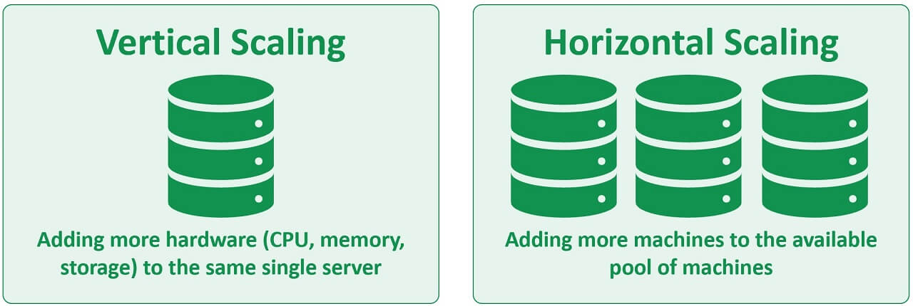
Benefit of nosql database ( document database)

Slide 32
comparison
Comparing | SQL | NoSQL
Data model | Relational | Non-relational
Database type | Table | Key-value, document, wide-column, and graph
Schema | Predefined | Dynamic
Query Language | Structured query language (SQL) | No declarative query language
Popular database management systems | MySQL, PostgreSQL, Oracle, and MS-SQL | MongoDB, Apache HBase, Amazon DynamoDB, Redis, Couchbase, Cassandra, and Elasticsearch

Slide 33
comparison
Comparing | SQL | NoSQL
Ability to scale | Vertical | Horizontal
Hardware | Specialized DB hardware (Oracle Exadata, etc.) | Commodity hardware
Open-source | A mix of open-source like Postgres & MySQL, and commercial like Oracle Database. | Open-source
Advantages | Cross-platform support, secure and free | Easy to use, high performance, and flexible tool
Disadvantages | Complex to maintain and inefficient if processing big data | Data is less structured, NoSQL databases are newer and may offer less features than their SQL counterparts

Slide 34
So which database to use ?
Both SQL and NoSQL are actually great database technologies, and both are widely used in the modern world.
Each has its own strengths and weaknesses that make it suitable for certain types of databases.

Slide 35
When to use sql?
1. When Your Data is Structured
If you are dealing with data that is static in nature and doesn’t change, then using SQL will get the job done effectively.
Example : Bank account data, a table for transactions
2. If Security is Your Priority
SQL is the technology used in accounting systems and transaction databases, as it requires consistency and has no room for error, as it ensures that even large data transactions are secure and consistent.

Slide 36
When to use nosql?
1. When Your Data is UnStructured
If you expect a massive growth with your data, then using NoSQL is a wiser choice because it allows you to work with high volumes of unstructured data.
Example : Twitter, Facebook, and Google use it to manage a staggering amount of data on a daily basis.
2. If Flexibility is Your Priority
NoSQL gives users much more flexibility to manage and manipulate data as the syntax isn’t rigid and depends on the database we are working on.

